Slide 1


NMR Spectroscopy
By
Dr. S. Khalid Hasan
Professor (Chemistry)
Department of Applied Sciences & Humanities
Institute of Technology & Management
GIDA, Gorakhpur
drskhasan@yahoo.com

Slide 2
Introduction
Nuclear magnetic resonance spectroscopy (NMR) is a tool for studying molecular properties, particularly structural properties of spinning nuclei.
NMR spectroscopy have very long wavelength of Radio Frequency Range 4-900 mega Hertz
(λ=10⁷μ (10m) to 10⁸μ (100m))
NMR spectroscopy involves the transition of a nucleus from one spin state to another with the absorption of electromagnetic radiation by spin active nuclei when they are placed in a magnetic field.
Certain nuclei, such as the hydrogen nucleus, have a nuclear spin.

Slide 3
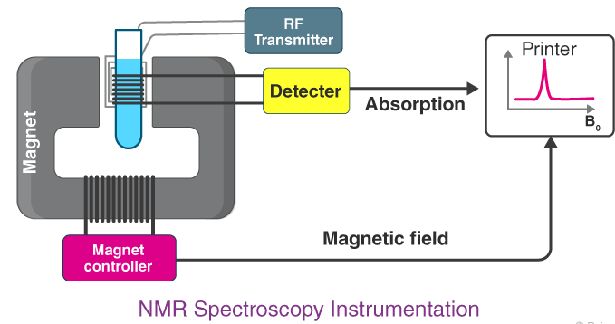

Slide 4
Magnetic properties of Nuclei
Nucleus: A Tiny Magnet
The nucleus of certain isotopes (H¹) behave as tiny spinning bar magnet because it possesses both electric and magnetic spin.
Effect of External Magnetic Field:
When a magnetic nucleus H¹ is placed in a uniform external magnetic field, it can only adopt two orientations with respect to the applied external magnetic field.
1. Either aligned with the field (Parallel spin) or
2. Opposite to the external field (anti-parallel spin)

Slide 5
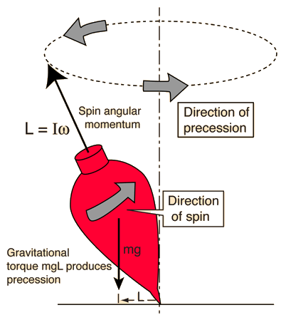

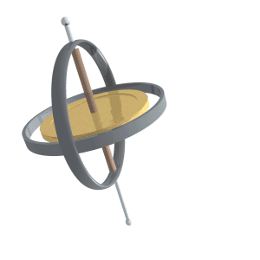
Precessional Motion:
The precessional motion of the nucleus can be understood by taking an example of spinning top, the spinning axis which move around the vertical axis of earth’s gravitation.

Slide 6
The spinning nucleus generates a small magnetic field, ‘μ’. When placed in a strong external magnetic field H_{o}, the nucleus can exist in two distinct spin states:

Slide 7
Nuclear Spin
The nuclei of many elemental isotopes have a characteristic spin (I).
Some nuclei have integral spins (e.g. I = 1, 2, 3 ....),
some have fractional spins (e.g. I = 1/2, 3/2, 5/2 ....),
and a few have no spin, I = 0 (e.g. ¹²C, ¹⁶O, ³²S, ....).
Mass No. | Atomic No. | Nuclear spin
odd | Odd or even | 1/2, 3/2, 5/2……
even | even | 0
even | odd | 1, 2, 3, ……

Slide 8

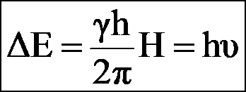
The condition for absorption of energy is called the condition of resonance. It can be calculated as the following:
h = Planck’s constant
H = The strength of the applied magnetic field, H_{o}, at the nucleus
γ = The gyromagnetic ratio (a constant that is characteristic of a particular nucleus)
υ = the frequency of the electromagnetic energy absorbed that causes the change in spin states

Slide 9
Three features of NMR spectra
1. NMR Signals corresponding to types of H
Depending upon the surrounding of a hydrogen atom there are two types of hydrogen
a. Equivalent Hydrogen:
b. Non-equivalent Hydrogen
Let us consider the example of diethyl ether CH₃CH₂-O-CH₂CH₃
The six methyl hydrogens (a) and
the four methylene hydrogens (b)
comprise two individual magnetically equivalent groups of hydrogens. The methyl hydrogens (a) experience a different total magnetic field than the methylene hydrogens (b), because of different local magnetic fields.

Slide 10
The areas of the signals are directly proportional to the number of hydrogen. So, in the case of diethyl ether CH₃CH₂OCH₂CH₃, the two peaks have an area ratio of 3:2 (or 6:4), because there are six methyl hydrogens (a) and four methylene hydrogens (b).

Slide 11
2. The Chemical Shift
When an organic molecule is placed in an external magnetic field, H_{o}, each hydrogen nucleus experiences a total field that is the sum of H_{o} and two other local magnetic fields: one produced by bonding and non-bonding electrons, H_{e}, and the other produced by neighboring protons which possess a nuclear spin, H_{h}. Thus, the applied magnetic field (H_{o}) is constant, while the magnetic fields produced as H_{e} and H_{h} are not constant. The magnetic field produced by the neighboring electrons (H_{e}) determines the position (relative frequency) of an NMR peak, called the chemical shift.
Thus, The difference in the absorption position of the proton with respecte to reference (TMS) signal is called as Chemical Shift.
δ = (υ_{sample}−υ_{Ref})/υ_{Ref}) × 10⁶

Slide 12
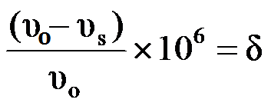
Tetra methyl silane (TMS) as Reference compound
Si(CH₃)₄
The TMS is used as a reference compound. It has 12 equivalent hydrogens. The position of an NMR signal is recorded relative to the position of the signal of an internal standard. This standard is commonly tetramethyl silane (TMS), (CH₃)₄Si. If TMS absorbs at frequency ν_{s}, and the hydrogen nucleus of interest absorbs at ν₀, the spectrometer will record a signal at
where υ_{o} is the spectrometer frequency (commonly 60 megacycles per second). δ is called the position of absorption, or the chemical shift,
τ -Scale: TMS is given an arbitrary value 10 ppm, Thus, τ = 10-δ

Slide 13
Shielding and Deshielding
When a molecule is placed in a magnetic field, its electrons circulate and produce a secondary magnetic field i.e., induced magnetic field. Rotation of electron about the nearby nuclei generates a field that can oppose or reinforce the applied field at the proton.
If the induced field oppose the applied field, the proton is said to be Shielded. Shielding shift the absorption Upfield.
2. If the induced field reinforces the applied field, the proton is said to be Deshielded. Deshielding is caused by adjacent atoms which are strongly electronegative (e.g. oxygen, nitrogen, halogen) or groups of atoms which possess π-electron clouds (e.g. C=O, C=C, aromatics).
Such shifts in in the position NMR absortion which arise due to shielding or deshielding of protons by the electrons are called as Chemical Shift.

Slide 14
Shielded proton:
Higher field (Up field) → Lower value of δ
De-shielded proton:
Lower field (Down field) → Higher value of δ

Slide 15
The NMR spectrum of benzyl acetate.
There are three absorptions corresponding to the three sets of magnetically equivalent hydrogens. The relative area of the peaks corresponds to the number of hydrogens in each set (CH₃COO CH₂C₆H₅ 3:2:5), peak intensity corresponding to the number of equivalent hydrogens).

Slide 16
3. Spin-Spin Coupling (Effect of adjacent number
of hydrogens) Splitting of signals
The source of signal splitting is a phenomenon called spin-spin coupling, a term that describes the magnetic interactions between neighboring, non-equivalent NMR-active nuclei. The magnetic field produced by neighboring protons affects the splitting of the NMR absorption. The peaks can appear as singlets, doublets, triplets, etc… Let’s first consider the absorption of a hydrogen atom (H_{x}) with only one neighboring hydrogen atom (H_{y}).

Slide 17
When there are two magnetically equivalent adjacent hydrogen nuclei, three possibilities exist for their combined magnetic fields Triplet
}

Slide 18
When there are three magnetically equivalent neighboring hydrogen nuclei , the absorption splits into a quartet with intensity pattern 1:3:3:1.

Slide 19
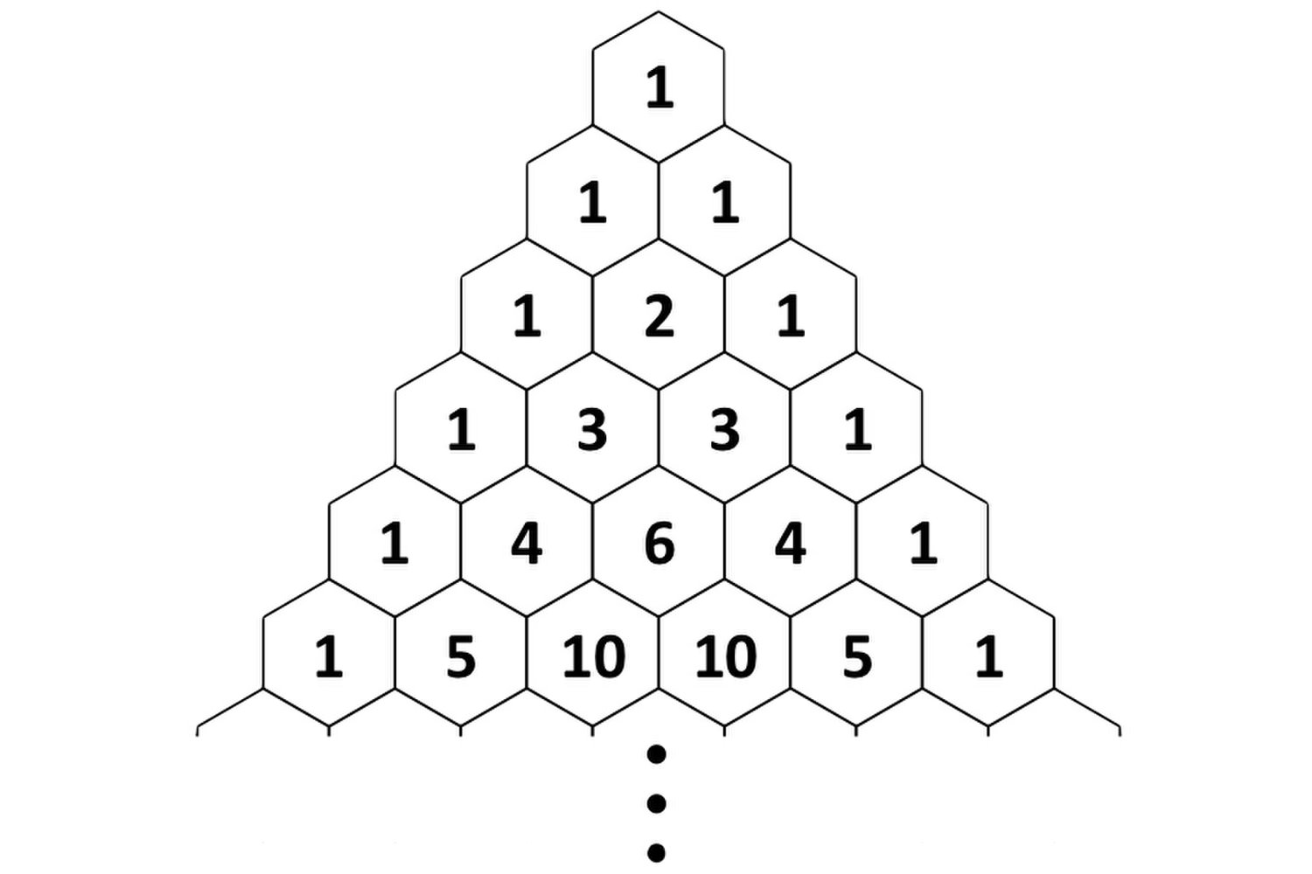
In general, N magnetically equivalent neighboring hydrogen nuclei will split the absorption into N+1 lines. The intensity ratios are equal to the coefficients of the expansion (a + b)^{N}, or Pascal’s triangle.

Slide 20
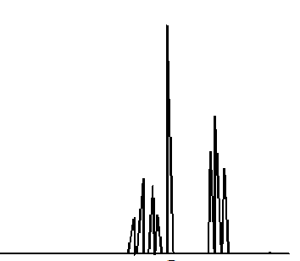
For example, in the molecule 2-butanone, hydrogens from groups a and b split one another because they are only separated by three bonds. However, hydrogens from group c are not split by any other hydrogens because they are separated from other hydrogens by more than three sigma bonds.

Slide 21
Ethanol gives an NMR spectrum consisting of a triplet, quartet, and a singlet, as seen in the spectrum. Even though the hydroxylic proton is separated from a methylene hydrogen by three bonds, the signal given by the hydroxylic proton is not split by the methylene protons, nor are the methylene hydrogens split by the hydroxylic proton.
OH CH₃ CH₂

Slide 22
Multiplicity in Proton NMR
The number of lines in a peak is always one more (n+1) than
the number of hydrogens on the neighboring carbon. This table summarizes coupling patterns that arise when protons have different numbers of neighbors.
No. of lines | ratio of lines | Term for peak | Number of neighbors
1 | - | singlet | 0
2 | 1:1 | doublet | 1
3 | 1:2:1 | triplet | 2
4 | 1:3:3:1 | quartet | 3
5 | 1:4:6:4:1 | quintet | 4
6 | 1:5:10:10:5:1 | sextet | 5

Slide 23
Questions
1. How many kinds of H¹ are there in
a. CH₃-CH₂-CH₃ b. CH₂=CH₂
c. CH₃-CH=CH₂ d. C₆H₅-CH₃
2. How many NMR signals do you expect in following
    CH₃OCH₃ b. CH₃OCH₂CH₃
    c. C₆H₅-CH₃ d. CH₃CH₂OH
3. Discuss splitting pattern in following
a. CH₃OCH₂CH₃ b. CH₃CH₂OH
c. CH₂=CHCl
4. Define the terms
a. Chemical Shift b. Spin-spin coupling
5. What is TMS.

Slide 24
Thank You

