Slide 1
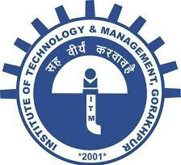
Band Theory
According to molecular orbital theory, when two or more atomic orbitals are combined, two or more molecular orbitals are formed.
1. Bonding molecular orbital: which has lower energy than that of atomic orbitals.
2. Antibonding molecular orbital: which has higher energy than that of atomic orbitals.

Slide 2
When a large number of atomic orbitals are combined, two sets of very closely packed atomic orbitals are formed. These sets of closely packed atomic orbitals are caleed as Bands. These are of two types.
Valence Band: It is completely filled and has lower energy.
Conduction Band: It is vacant and has higher energy.
Energy Gap (Forbidden Zone):
The gap between valence band and conduction
band is called as Forbidden Zone or
Energy Gap.

Slide 3
Li (3) is², 2s¹
Vacant
Conduction Band
Antibonding
Energy Gap (Forbidden Zone)
Nonbonding
Completely Filled
Valence Band
Bonding
Li₁ Li₂ Li₃ Li₄ Li₁₀ Li_{n}
1e 2e 3e 4e 10e ne

Slide 4
Conductors, Insulators and Semi-conductors
on the basis of Band theory
Conductors
In a conductor there are no band gaps (Energy Gap) between the valence and conduction bands. In some metals the conduction and valence bands partially overlap. This means that electrons can move freely between the valence band and the conduction band.
Energy Gap Negligible (less than 1 eV)

Slide 5
Semiconductors
In a semiconductor, the gap between the valence band and conduction band is smaller. At room temperature there is sufficient energy available to move some electrons from the valence band into the conduction band. This allows some conduction to take place.
An increase in temperature increases the conductivity of a semiconductor because more electrons will have enough energy to move into the conduction band.
Energy gap 1-3 eV
Small

Slide 6
Insulators
An insulator has a very large gap between the valence band and the conduction band so that no electrons can move up to the conduction band. As a result, the conduction band is empty.
The insulators can not conduct electricity.
Energy Gap more than 5 eV
Very Large

Slide 7
Small
Energy Gap
Very Large
Conductor
No Band Gap
Semi-conductor
Gap more than in Conductor
Insulator
Very Large Band Gap

Slide 8
Liquid Crystal
1. Liquid crystal (LC) is a state of matter that has properties between those of conventional liquids and those of solid crystals.
2. When most solids melt, they form an isotropic fluid, whose optical, electrical and magnetic properties do not depend on direction.
However, when some materials melt, over a limited temperature range they form a fluid that exhibits anisotropic properties i.e. different physical properties in different directions.

Slide 9
Liquid Crystal
3. Liquid crystals are a unique state of matter between solid (crystalline) and liquid (isotropic) phases.
4. Some compounds form a distinct, different intermediate phase, sometimes referred to as the “fourth state of matter” or “mesophase” or Mesomorphic state.
5. These compounds display properties of both solid and liquid.
6. They can flow like a liquid and a well ordered regular arrangement like a crystal.

Slide 10
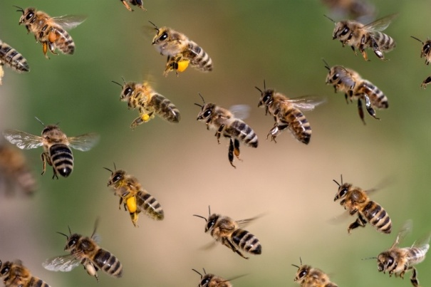
Move like swarm
Examples
Methoxy Cinnamic Acid CH₃O- -CH=CH-COOH
P-azoxyanisole CH₃O- -N=N- -OCH₃
O
Cholestric Benzoate C₆H₅COOC₂₇H₄₅

Slide 11
Y– – X – –Y’
X = Azo –N=N–, Azoxy –N=N– Ester –O–C–
O O
Unsaturated –CH=CH– –C≡C–
Y and Y’ are small groups or side chain

Slide 12
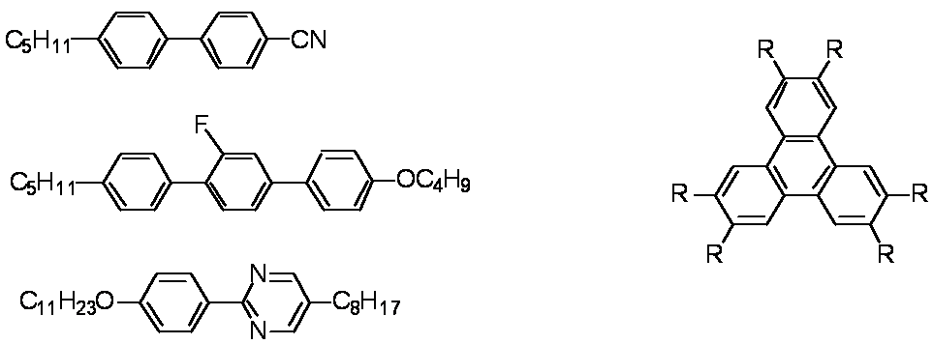
Mesogen
Mesogen is the fundamental unit of Liquid Crystal that includes structural order in the crystal.
A liquid crystal molecule consists of a rigid moiety and one or more flexible parts.
The rigid part aligns molecule in one direction, whereas flexible parts induce fluidity in the liquid crystal.
Rod Like Disc Like

Slide 13
Crystal
Regular arrangement
Liquid Crystal
Meso Phase
Intermediate state
Liquid
Random arrangement
Temperature
Solid Turbid Liquid Clear Liquid
Temperature

Slide 14
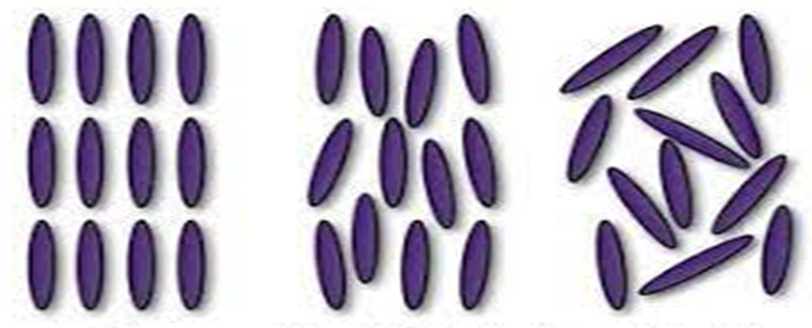
Liquid Crystal
Crystal
(Solid)
Positional and orientational order both
Liquid Crystal
No Positional order but has orientational order
Liquid
Neither Positional nor
orientational order

Slide 15
Classification of Liquid Crystals
Liquid crystals show
Thermotropic behaviour
Thermotropic behaviour means the compounds are liquid crystalline within a defined temperature range, below this range compounds are crystalline and above it compounds are isotropic liquids. Thermotropic liquid crystalline compounds also require no solvent.

Slide 16
Lyotropic behaviour
Lyotropic liquid crystals are dependent on solvents.
Lyophilic (solvent loving) and
Lyophobic (solvent hating)
Amphiphilic Liquid Crystal are both lyophilic and lyophobic.
Lyotropic LCs have a polar head group attached to nonpolar chain
Examples biological membranes, cell membranes,

Slide 17
Liquid Crystal
Thermotropic
(Temperature Dependent)
Rod Like
Lyotropic
(Solvent Based)
Disc Like (Discotic)
Cholestric
Nematic
Smectic

Slide 18
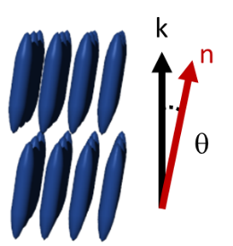
Types of Liquid Crystal
There are mainly three types of liquid crystal:
Nematic,
Smectic and
Cholesteric.
In the liquid crystalline phase, the
vector about which the molecules
are preferentially oriented, n, is
known as the "director". The long
axes of the molecules will tend to
align in this direction.

Slide 19
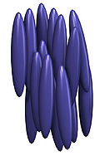
Nematic
One of the most common LC phases is the
nematic. The word nematic comes from
the Greek-nema), which means "thread".
1. A nematic phase, the calamitic or rod
shaped organic molecules
Have no positional order, but they self-align to have long-range directional order.
Point in same direction
Start and stop at different position
Thread Like

Slide 20
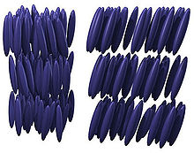
2. Smectic
The smectic (Soap-Like) phases, which are found at lower temperatures than the nematic.
Form well-defined layers that can slide over one another in a manner similar to that of soap.
The word "smectic" originates from the Latin word "smecticus", meaning cleaning, or having soap-like properties.
Smectic A: Arranged in layers, director is perpendicular to the plane
Smectic C: Arranged in tilted layers
Smectic A Smectic C

Slide 21
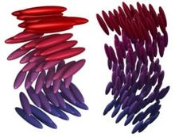
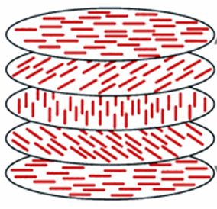
3. Cholestric
This phase is often called the cholesteric phase because it was first observed or cholesterol derivatives.
The chiral nematic phase exhibits chirality. Only chiral molecules can give rise to such a phase.
Twisted (Spiral) Nematic structure.
No orderly orientation.

Slide 22
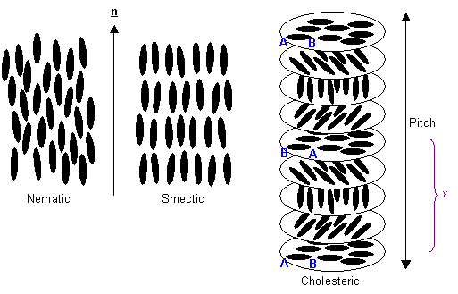
Nematic
Smectic
Cholsetric

Slide 23
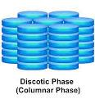
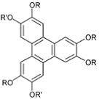
Discotic Liquid Crystals
They have multi layerd disc like structure, also known as Calamatic Liquid Crystal

Slide 24
Applications of Liquid Crystals
1. Liquid Crystal Displays: (Optoelectronic Display)
The most common application of liquid crystal technology is liquid crystal displays (LCDs.) in calculator, computer, television etc.
2. Liquid Crystal Thermometers:
The Chiral nematic (cholesteric) liquid crystals reflect light with a corresponding wavelength. It can detect the temperature according to the colour.
3. Electroluminescence: which can be used in organic light emitting diodes

Slide 25
4. Optical Imaging: An application of liquid crystals that is only now being explored is optical imaging and recording.
This technique is also used for the visualization of RF (radio frequency) waves.
5. Molecular sensors and detectors
6. Optical connectors and switches
Photovoltaic devices
As commercial Lubricant

Slide 26
Home work
Differentiate Conductors, Semiconductors and Insulators on the basis of Band Theory
Differentiate Nematic, Smectic and Cholestric Liquid Crystals.
Write down some applications of Liquid Crystals

